Slide 1
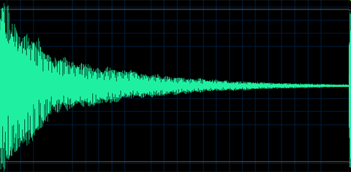
MOTIVATION

Slide 2
MOTIVATION
The psychological feature that arouses an organism to action toward a desired goal; the reason for the action; that which gives purpose and direction to behavior.
Motivation is the set of reasons that determines one to engage in a particular behavior.
Notes:
Drive theory. Drive is a psychological state that occurs because of physiological need.

Slide 3
Theories
Drive theory. Drive is a psychological state that occurs because of Physiological need. Drive reduction theory states that physiological need creates an aroused state that motivates to satisfy need. Homeostasis

Slide 4
Abraham Maslow’s Hierarchy Theory:
Maslow saw human needs in the form of a hierarchy, ascending from the lowest to the highest, and he concluded that when one set of needs is satisfied, this kind of need ceases to be a motivator.

Slide 5
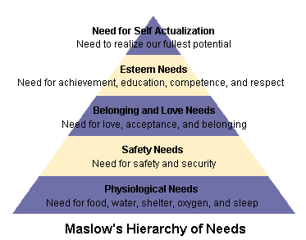

Slide 6
TYPES OF MOTIVES
BIOLOGICAL MOTIVES
Oxygen
Hunger
Thirst
Sex
Avoidance of Pain
Temperature regulation
Bladder tension
Fatigue

Slide 7
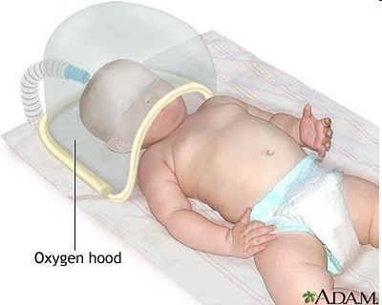
Oxygen:
oxygen is the most basic need of every living being without it no one can survive.

Slide 8
Homeostasis: biological “thermostats”
  homeostasis is a process by which internal body mechanisms sense biological imbalances and stimulate action to restore the proper balances
  Or The body tendency to maintain an equilibrium or balance
  homeostatic controls exist for hunger, thirst, body temperature, electrolyte levels, etc.
  we will discuss hunger and thirst motives in detail next.

Slide 9
2. Hunger:
Role of stomach cues
Role of the brain
Eating Disorders
1. Obesity
2. Anorexia Nervosa
3. Bulimia

Slide 10
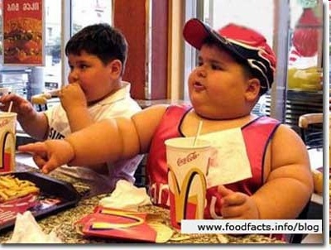
Brain,Hypothalamus,
Ventromedial,obese
Lateral ,starvation
Obese: Their body
weight more than 20% of
average weight compared
to height.
Hypersensitive to
external cues
a. Higher set-point
b. Lower metabolism
c.Hypothyroidism

Slide 11
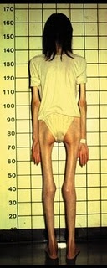
Anorexia nervosa
Self-starvation and dramatic weight loss - 25% of normal body weight
70% recover and maintain normal body weight
Usually they are young females
Causes:
Ventromedial hypothalamus; obese
Lateral hypothalamus; starve

Slide 12
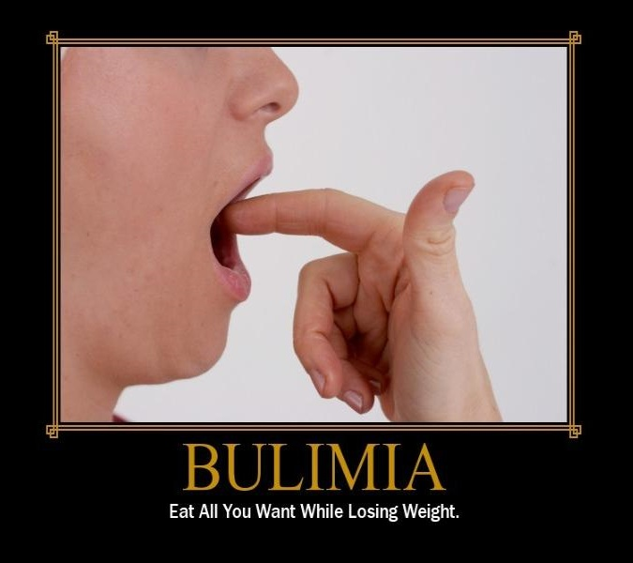
Bulimia
Eating quantities of food and then eliminating it by self-induced vomiting or strong laxatives
99% are female, a majority are college students
Do maintain a "normal" body weight - are in "control" .

Slide 13
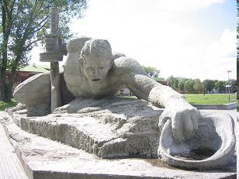
3. Thirst:
Thirst is the regulation of fluid intake
Biological regulation of thirst
  a “drink” and a “stop drinking” center are located in different sections of the hypothalamus
  homeostatic
  DEHYDRATION
  Blood loss also cause thirst.

Slide 14
4. Sex Motive:
The biological need for sex is an unusual physical motive in such an individual can survive an entire lifetime without once satisfying it,but this need is Important for survival of the human race.
Role of hormones

Slide 15
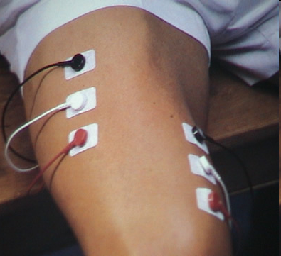
5. Avoidance from pain:
Every one wants to get rid of pain.

Slide 16
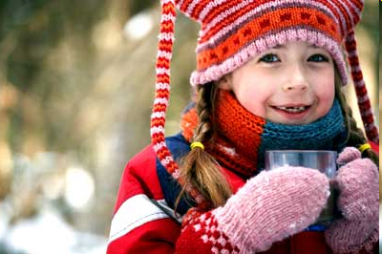
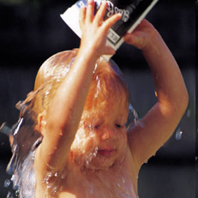
6. Temperature regulation:
This is obtained through the use of clothing, location, and the building of protecting structures. 98.6 degrees or 37degree celsius

Slide 17
7. Bowel and Bladder tension:
All organisms create waste products via the processes of living. Much waste comes from food. The rest is produced by movement, growth, and other functions of living. If this waste remained in living things, it would soon cause illness and death. Thus living things must have a way to dispose of waste matter.

Slide 18
Fatigue.
Tiredness ,lethargy in muscles.
Types of fatigue
SLEEP.
Hypothalamus,insomnia, Time span,psychological and physical effects

Slide 19
Social motives
Need for achievement:
Refers to an individual's desire for significant accomplishment, mastering of skills, control, or high standards.
The need for success in competitive situations
  fear of failure
    failure to try because of fear you might not succeed
  fear of success
    snatching defeat out of the mouth of victory because of fear of success

Slide 20
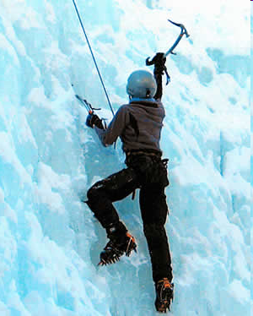

Slide 21
Need for affiliation:
The Need for Affiliation (N-Affil) is a term that was popularized by David McClelland and describes a person's need to feel a sense of involvement and 'belonging' within a social group. Every one wants to have friends. concept of attachment

Slide 22
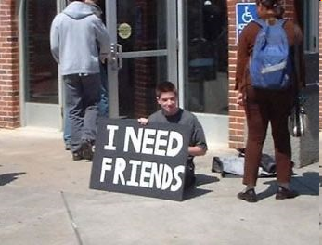

Slide 23
Need for Achievement
Highest in Maslow hierarchy
People high on Achievement are characterized by a tendency to seek challenges and a high degree of independence. Their most satisfying reward is the recognition of their achievements Need for Achievement is related to the difficulty of tasks people choose to undertake..

Slide 24
Need for power:
People who exhibit power tendencies are thought to be most satisfied by seeing their environment move in a certain direction, due to their involvements. As an example of the need for personal power, most corporate leaders seek high level positions so as to control the direction in which their company is moving.

Slide 25
Intrinsic and Extrinsic Motivation
Intrinsic motivation is stimulated by the inherent nature of the activity itself; by the process itself and with no external rewards
Extrinsic motivation is stimulated not by the process itself but by what can be gotten from doing the activity, e.g., a reward or recognition or other gain

Slide 26
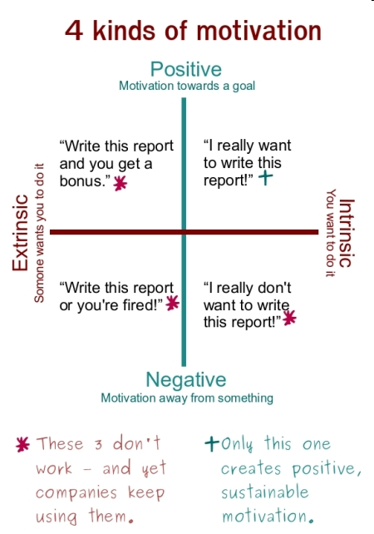

Slide 27
Theories
Motivational need theory
David Mcclelland
Need to Achieve(n.ach)
Need to Power(n.pow)
Need for Affiliation(n.affil)

Slide 28
Equity theory,Motivation in Management.
J.Stacy Adams
Input—Output
Expectancy and Management control.
Victor Vroom
Expectancy model:Valence,outcome,expectancy,
Instrumentality

